Slide 1

______________________________________________________________________

Slide 2
Role Of Team Member
Jyoti Rani:
*POM structure
*Extent Report, Allure Report
*Integration of Jenkins
*Integration of Git
*Test Scenarios 2 & 4
ShikhaAwasthi
*Utilities
*Object Repository
* Load Properties
*Locators
*Test Test Scenarios 2 & 4
Piyush Juneja
*Email
*Registration test & Registration page
*Test Scenarios 1, 3 & 5
*Sequential and parallel Execution
*Create_Project_Page

Slide 3

Objective __________________________________
Automating Sandox Application
Test Scenarios criteria
Register with a new user, login using that user: Create a project other than “X-ray”; Create a user story
Login using given credentials; Create a user story in X-ray project; Create a user story; Create a Test Plan
Register with a new user; Login using that user: Create a user story in X-ray project; Create a task
Login using given credential; Create a project other than X-ray; Create a user story; Create test case
Register with a new user; login using that user: Create a user story in X-ray project; Create test case

Slide 4
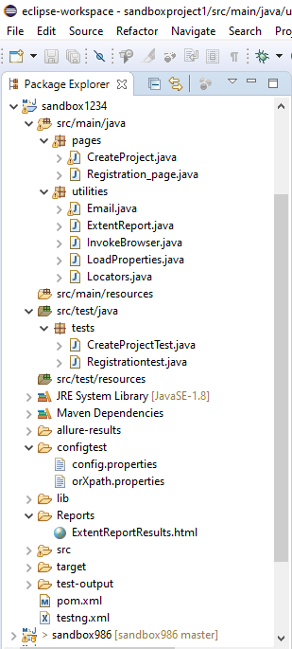
ACTIVITIES PERFORMED
POM (Page Object Model)
Is a design pattern to create Object Repository for web UI elements. Under this model, for each web page in the application, there should be corresponding page class.

Slide 5
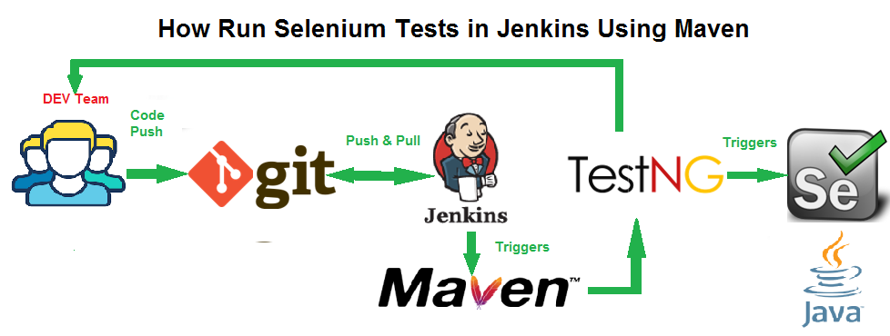
Jenkin & Git integration

Slide 6
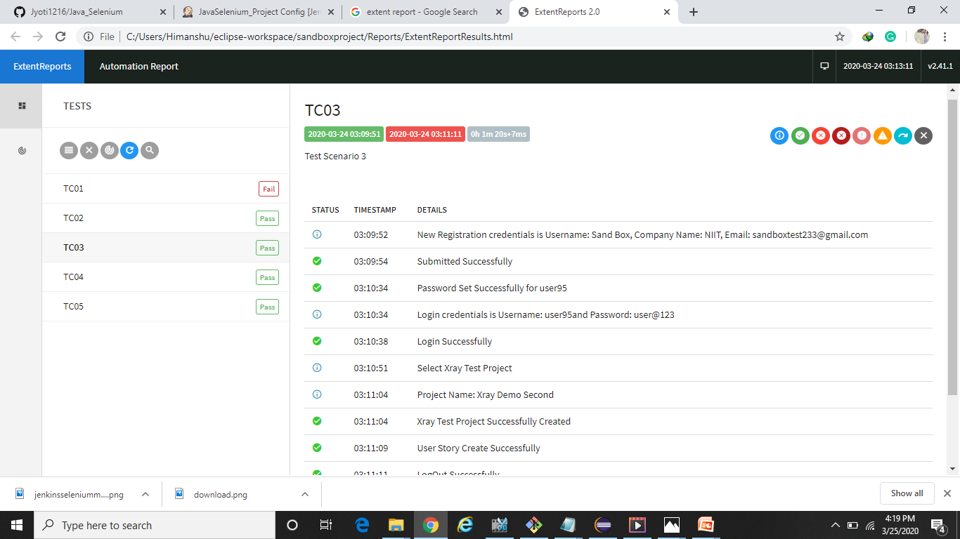
ExtentReports

Slide 7
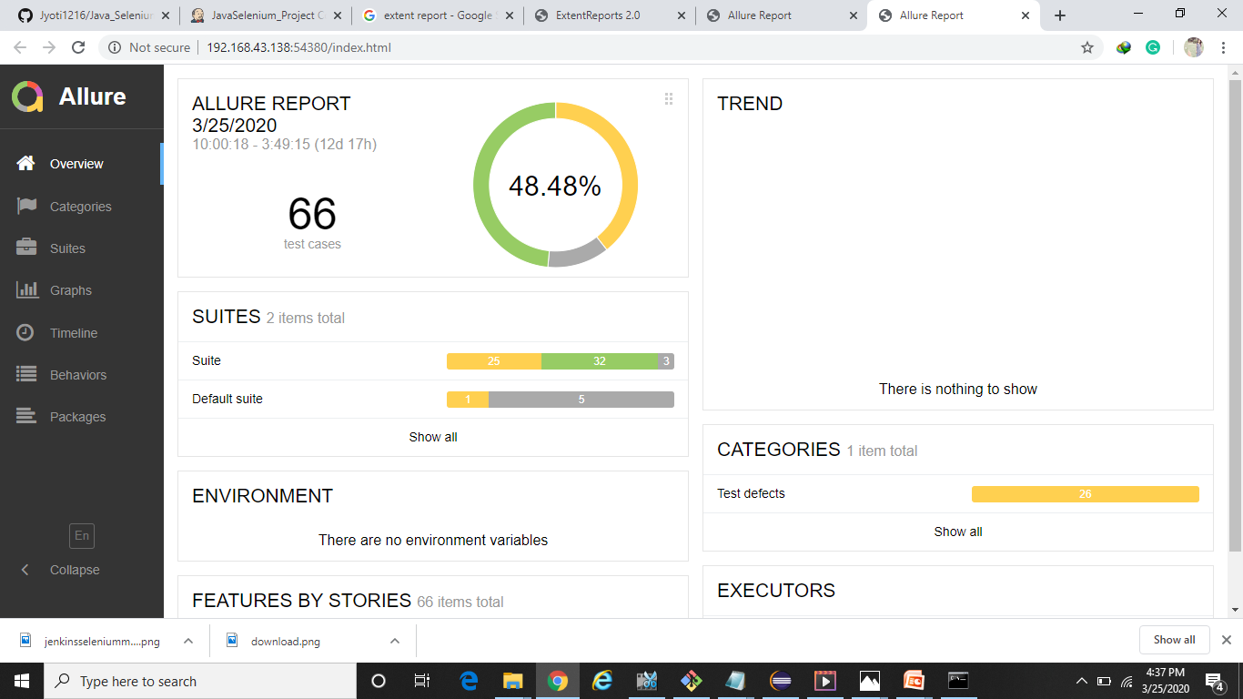
Allure Reports

Slide 8
THANK YOU

